Slide 1


Micro-Habitat Garden
HMN Focus Project in Waynesboro at the Wildlife Center

Slide 2
Headwaters Master Naturalists
These slides introduce you to the Focus Project of 2013-2014 for our chapter.
We’d love to have all members in some way— small or large—help out at some point by Fall 2014.
In addition to Master Naturalists, we will be getting some help from Master Gardeners and Wildlife Center volunteers, as well!

Slide 3

Project Mission Statement
To create a wildlife food garden that:
-Teaches the public about micro- habitats
- Displays ideas for using native plants in home gardens
- Introduces principles from permaculture design.

Slide 4
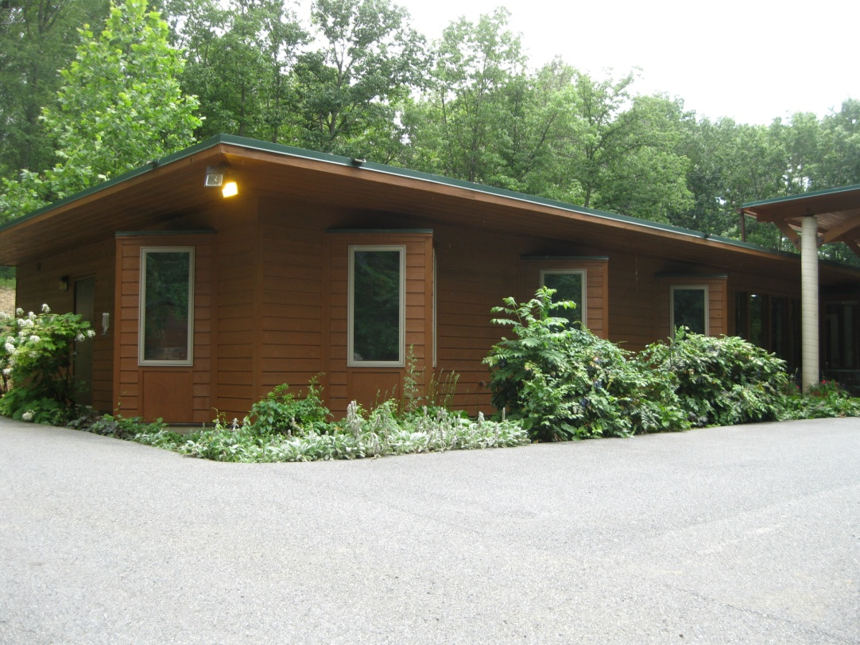
What is the garden space we are designing and installing?
We’re replacing this front bed of non-native invasive plants plantings and starting over!
The Wildlife Center is a non-profit veterinary hospital for wildlife located at 1800 S. Delphine Ave, in Waynesboro, VA ,540-942-9453.

Slide 5
What micro-habitats will be added?
Four interconnected sub-projects:
1. a pond micro-habitat
2. two wildlife food guild micro-habitats
3. a raised planter micro-farm to grow small crops for wild patients (or decorative annuals)
4. renovating, installing a sign that acknowledges donors, displays certification and teaches about home wildlife habitats.

Slide 6
Seeking Certification
We want this garden to meet the certification requirements by the National Wildlife Federation (NWF) as a “Backyard Wildlife Habitat.”
To do that, we have to make sure we are including the components they require– like food sources, water, hiding spots, and nesting spots.

Slide 7
A lot of design factors!
Design Constraints:
Physical space limitations-- light, water, soil type.
NWF’s certification requirements
Use some permaculture design principles
Keeping it inexpensive
Keep it low maintenance
Use native plants or native plant cultivars
Be able to get plants locally
Design for Zone 6 climate
Anticipate climate change

Slide 8
A lot of design factors!
Plus, of course we want it to be
Beautiful
Educational
Engaging
WOW!

Slide 9
What is “permaculture?”
Permaculture is a system of perennial agriculture emphasizing the use of renewable natural resources and the enrichment of local ecosystems.
Its Core Principles are:
Care of the Earth
Care of the People
Return of the Surplus

Slide 10
What is a“plant guild”
Similar to companion planting, a guild is designed to contain a community of species that:
-support each other in beneficial ways -aid in self-maintenance and
-reduce the work to maintain the system

Slide 11
What components make up a guild?
1. Food Plants
2. Food-for-the-Soil Plants (nitrogen fixers)
3. Climber Plants
4. Supporter Plants
5. Miner Plants
6. Groundcover Plants
7. Protector Plants

Slide 12
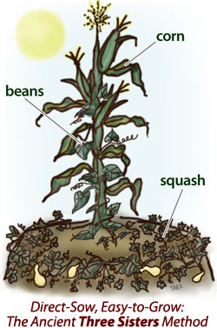
This is a well-known simple guild

Slide 13
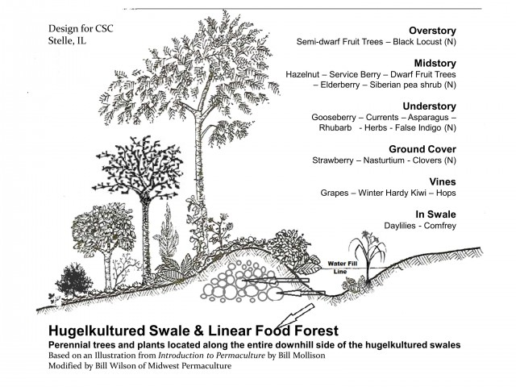
Plant Guild R&D

Slide 14
Okay, are you sold?
Here’s how you can get involved!
Join up with:
Team Water Pond!
Team Mini-Farm Planter!
Team Plant Guild!
Team Art and Signs!

Slide 15


What will Team Water Pond do?
Research and design pond shape, depth, installation requirements and create a budget
Figure out managing/using roof runoff from downspouts…(rainchains, rainbarrels?)
Select plants for the pond
Integrate design with other teams’ designs
Get and deliver plants and supplies
Install pond, plants and borders

Slide 16
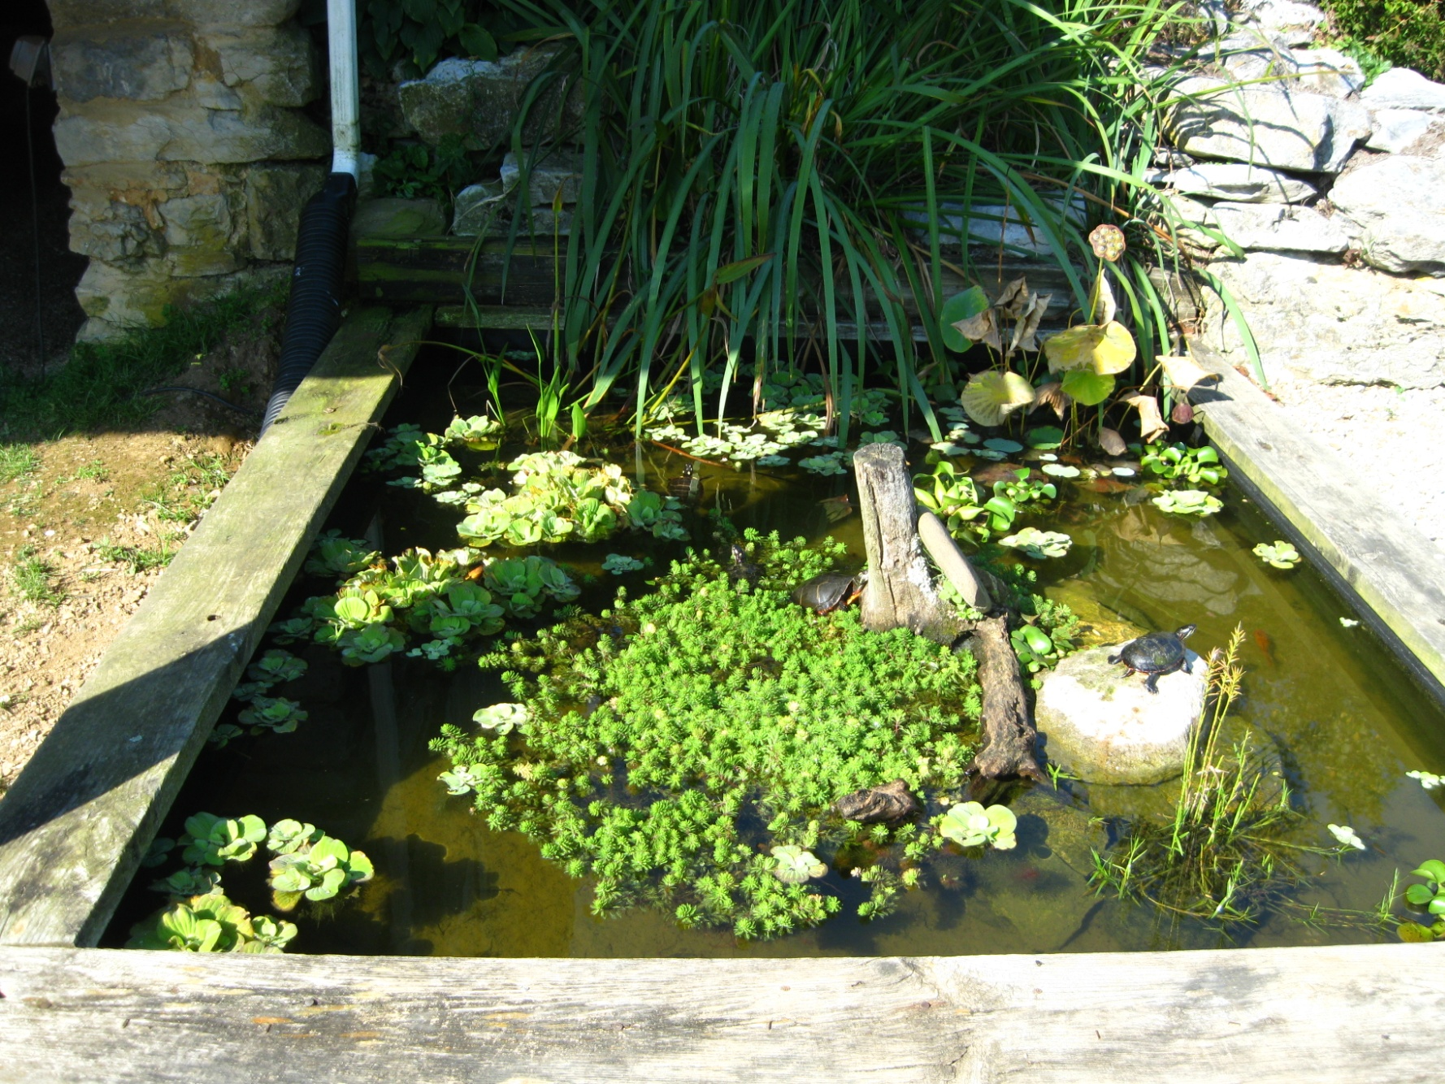
One possibility:

Slide 17
What will Team Plant Guild do?
Read up about guild design
Research and select plants for all layers of 2 guilds meeting the many design parameters
Create a budget
Pickup and deliver the plantings
Install the plantings
Integrate design decisions with other teams

Slide 18
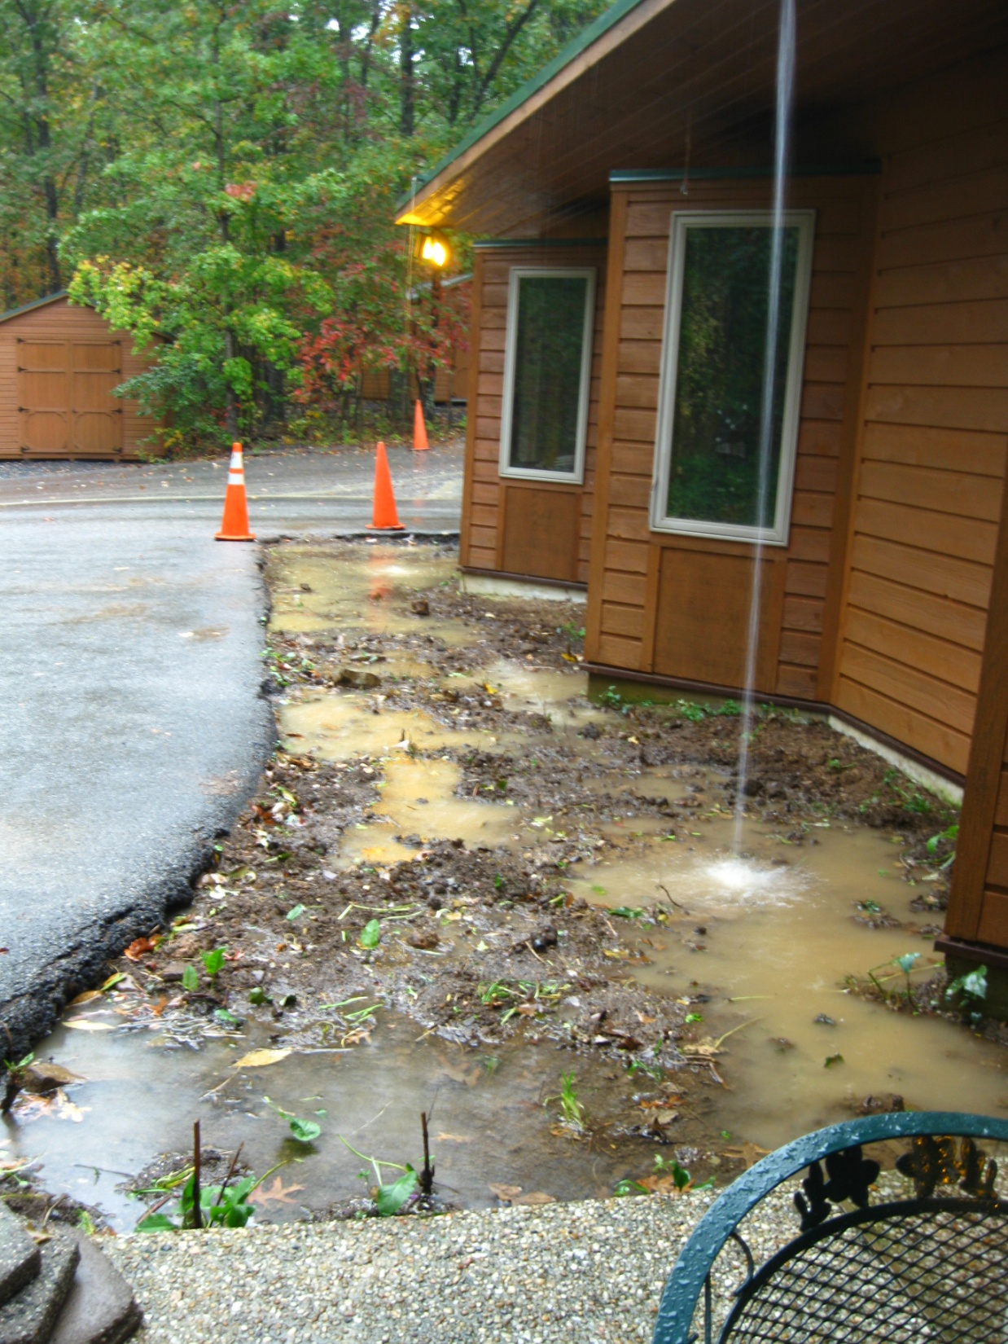
Here’s what the garden looks like in a heavy rain. See those weird gutter downpours. We have to design to utilize and manage that.

Slide 19
What will Team Mini-farm Planter do?
Design a structure that is attractive, functional and durable that coordinates with other teams’ designs
Create a budget
Construct/install the planter on or off-site
Select appropriate crops for the conditions
Get and deliver the seeds
Add and prepare the soil for spring crops.

Slide 20
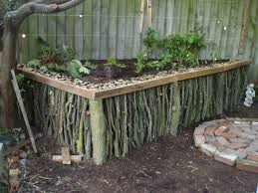
Some planter ideas…

Slide 21
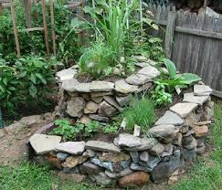
Some more ideas…

Slide 22
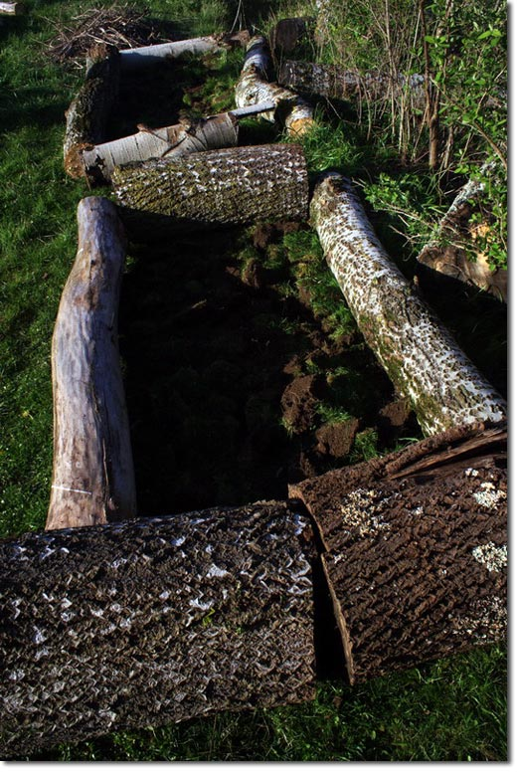
Lots of ideas!

Slide 23
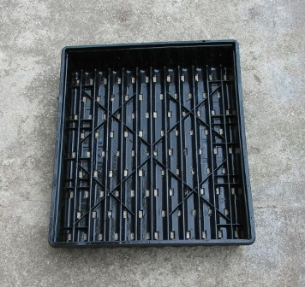
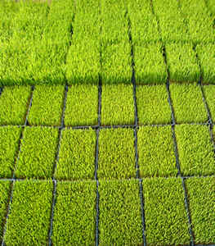
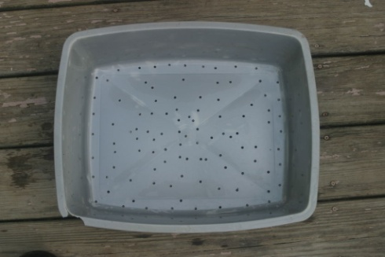
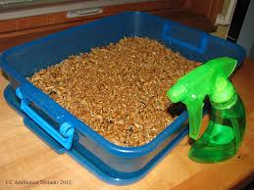
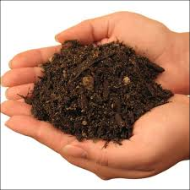
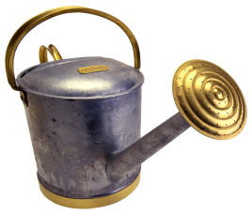

Dandelion/Clover Plots
Seeds very cheap, under $10, at local nurseries or garden supply (or just collect seeds on your own)
Use one of these (make sure there is sufficient drainage)
Can be put outside-just make sure it’s out of reach from wildlife
Organic material=dirt, compost, mulch

Slide 24
What will Team Art and Sign do?
Using an existing outdoor display board, design the copy and art for the sign to include donor names, certification signage as well as to teach and promote about wildlife food gardens and microhabitats
Create a budget
Add possible artful birdhouse and bat house
Shop and price signage creation
Get, deliver and install the materials

Slide 25
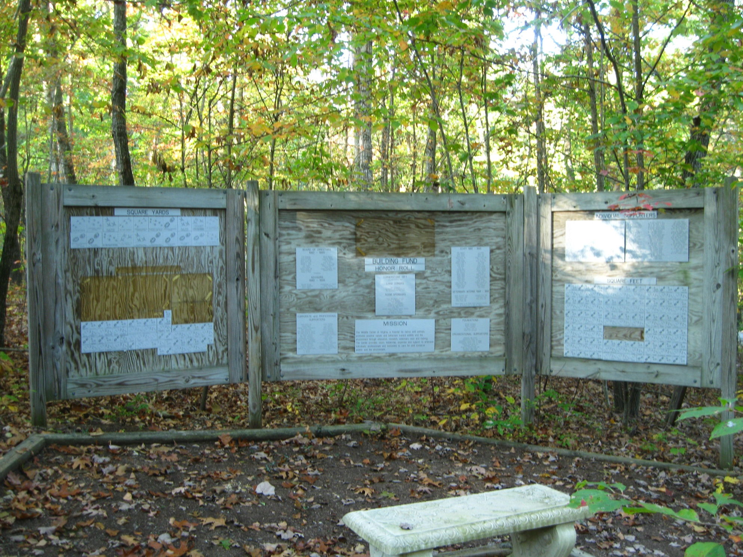
.
This is the current sign. It is solid, but needs a makeover!

Slide 26
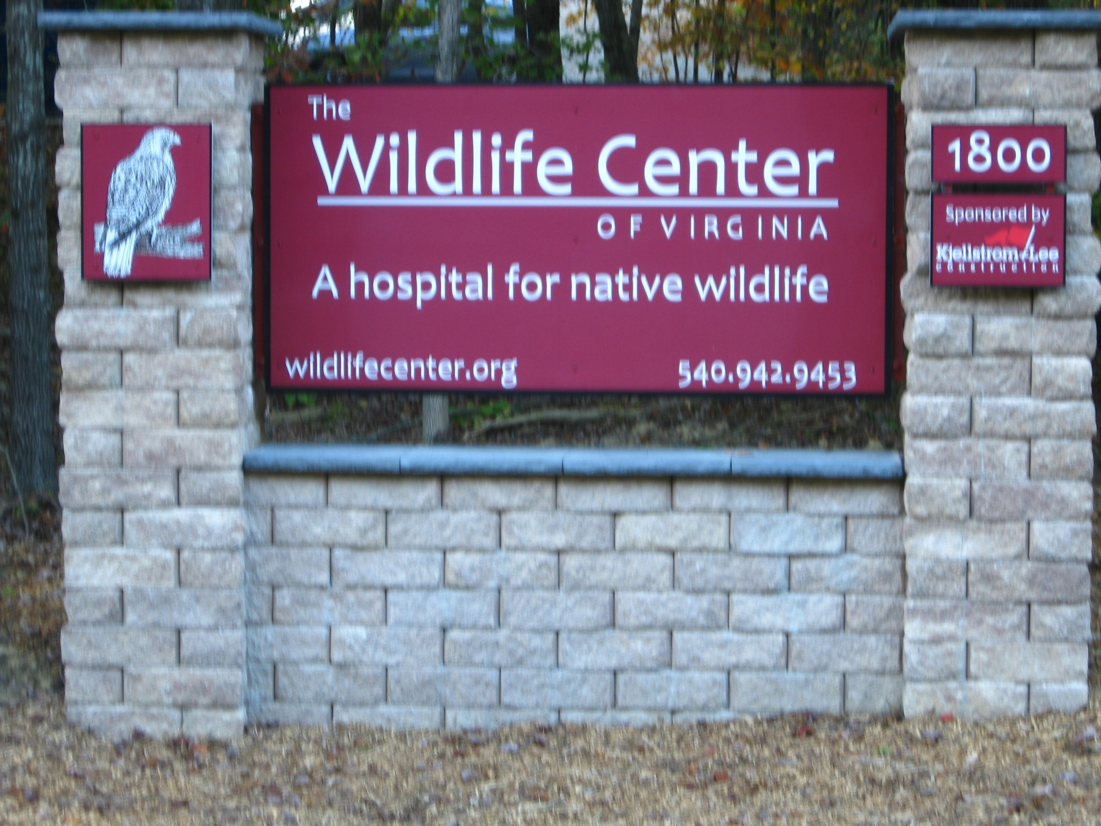
This is the main road sign. Whatever we do should take this sign into consideration and think about continuity of brand to some extent.

Slide 27
Design by Committee?
Sure, all ideas are welcome, especially in early brainstorming.
But, we need to remember that each of our pet ideas—wonderful and valid as they may be– may not get used in the end project.
We will use some professional and expert designers to look over what we come up with and make sure the overall design and function hangs together well.

Slide 28
No one has to “do it all”
There’re lots of small, discreet tasks you can do.
Hate gardening? You can cook for our workdays, shop for stuff needed, lead advanced training on party day… we’ll fit you in with on or off-site work.

Slide 29
We are looking forward to using your ideas and expertise!
Call or email Kate Guenther to volunteer! goatherderkate@yahoo.com
540-350-2824

